Slide 1

“From Installs to Insights: A Data-Driven Exploration of the App Market”

Slide 2
About us:
Team Member 01 :
DHANA TEJA DUMPA
I hold a postgraduate degree in Science and currently training in a Data Analytics course at INNOMATICS RESEARCH LABS.
Team Member 02 :
TIRUMALA DEVI DUDIGAM
I’ve recently graduated with a degree in Computer Science and Engineering and currently training in a Data Analytics course at INNOMATICS RESEARCH LABS.

Slide 3
Business Objective
Analyzing the App Market to Identify the Most Profitable Categories for Investment and Development Opportunities
Domain Knowledge:
To help investors and app developers make informed decisions, we need to understand which app categories are the most profitable and have the highest growth potential. This involves analyzing key factors such as install trends, user ratings, and category performance. By identifying the top-performing categories, we can highlight areas for strategic investment and app development opportunities.

Slide 4
Key Performance Indicators (KPIs):
Total Installs:
Measures the popularity of apps.
Higher installs indicate strong market demand.
Recent Installs:
Tracks current app popularity and growth trends.
Helps identify trending categories.
Rating:
Indicates user satisfaction and app quality.
Higher ratings suggest positive user experiences.
Category Performance:
Evaluates which app categories have higher installs and better ratings.
Helps identify the most profitable categories.

Slide 5
Objective of the Project
1. Website Selection : Selected AppBrain website for data extraction.
2. Web Scraping : Extract App-related data from the selected website using web scraping
techniques.
3. Data frame Creation: Organized the scraped data into a structured data frame for analysis.
4. Data Cleaning : Performed data cleaning to handle missing values, outliers, and inconsistencies
in the dataset.
5. Visualization : Created univariate, bivariate and multivariate plots to analyze numerical and categorical variables.
6. Insights : Derived meaningful insights from the visualizations to inform decision- making.

Slide 6
Tools & Libraries :
Web Scrapping
Request
Regex
Beautiful Soup
Python
Libraries
EDA
NumPy
Pandas
Data Visualization
Matplotlib
Seaborn

Slide 7
Dataset Overview
Data Source : AppBrain
The dataset contains 999 entries and 7 columns with various apps information. Here's a breakdown:
Field : Description
App Names : The name of the mobile application.
Category : The category or genre the app belongs to (e.g., Social, Tools, Shopping).
Rank : The app's position within the top 100 list for each country.
Rating : The average user rating of the app (out of 5).
Installs_no : The total number of installs for the app.
Recent : The number of recent installs the app has received.
Country : The country where the app is popular or listed.

Slide 8
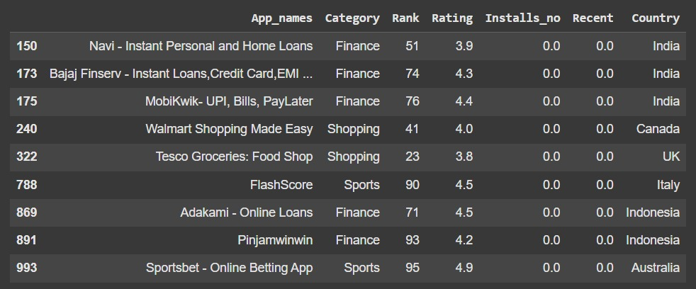
Data Exploration
Missing Values:
Reasons :
Delayed Updates : Install data may take time to reflect, while ratings show immediately
New or Updated Apps : Recently launched apps may have ratings from testers but no public installs yet.
Privacy Restrictions : Some apps hide install metrics due to privacy settings

Slide 9
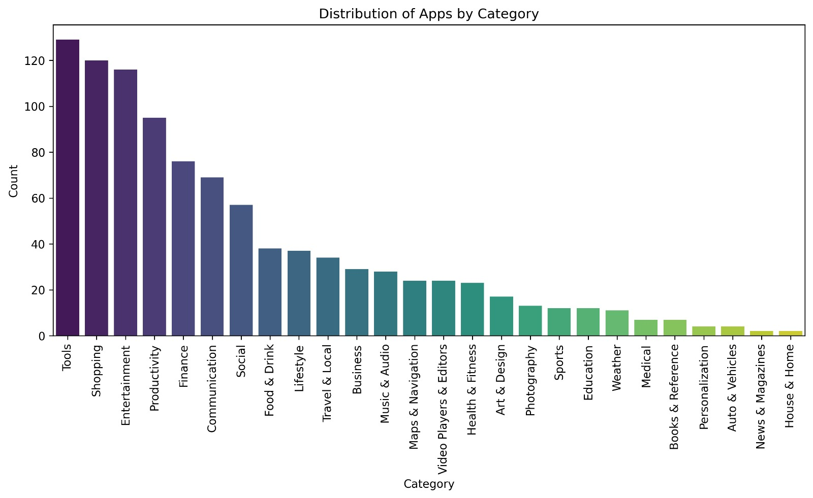
Univariate Analysis - Categorical
Top Categories: Categories with the most apps dominate the market, indicating high competition.
Niche Categories: Less frequent categories may offer opportunities with lower competition.

Slide 10
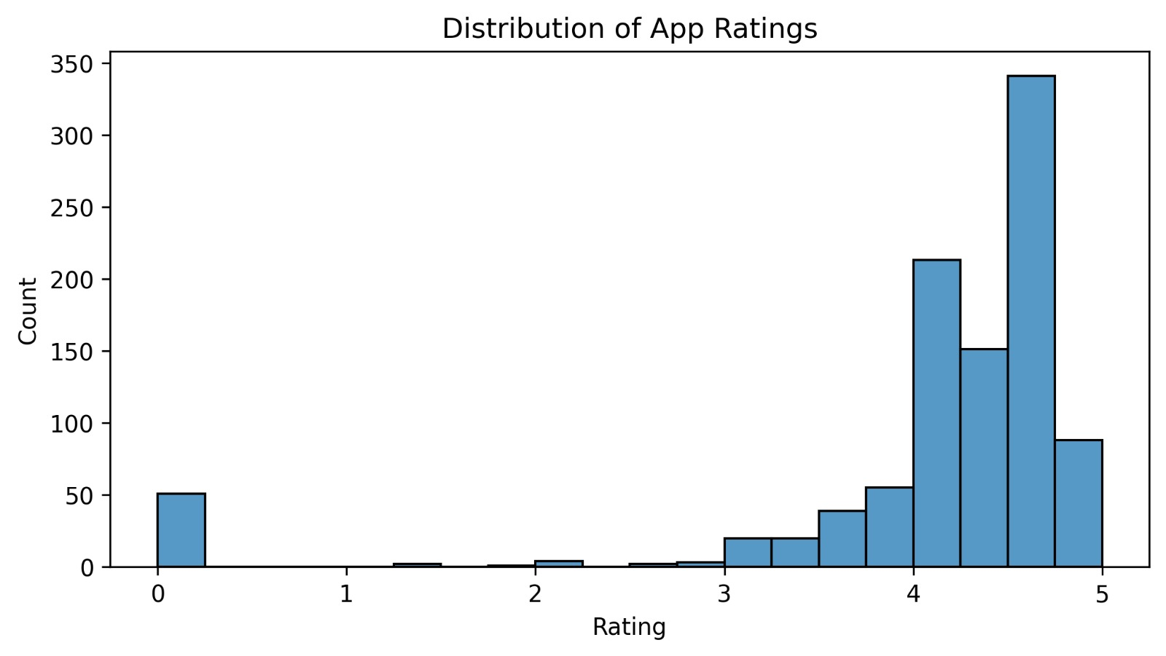
Univariate Analysis - Numerical
From this, we can determine that most apps are highly rated or we can say that the market is flooded with poorly rated ones.

Slide 11
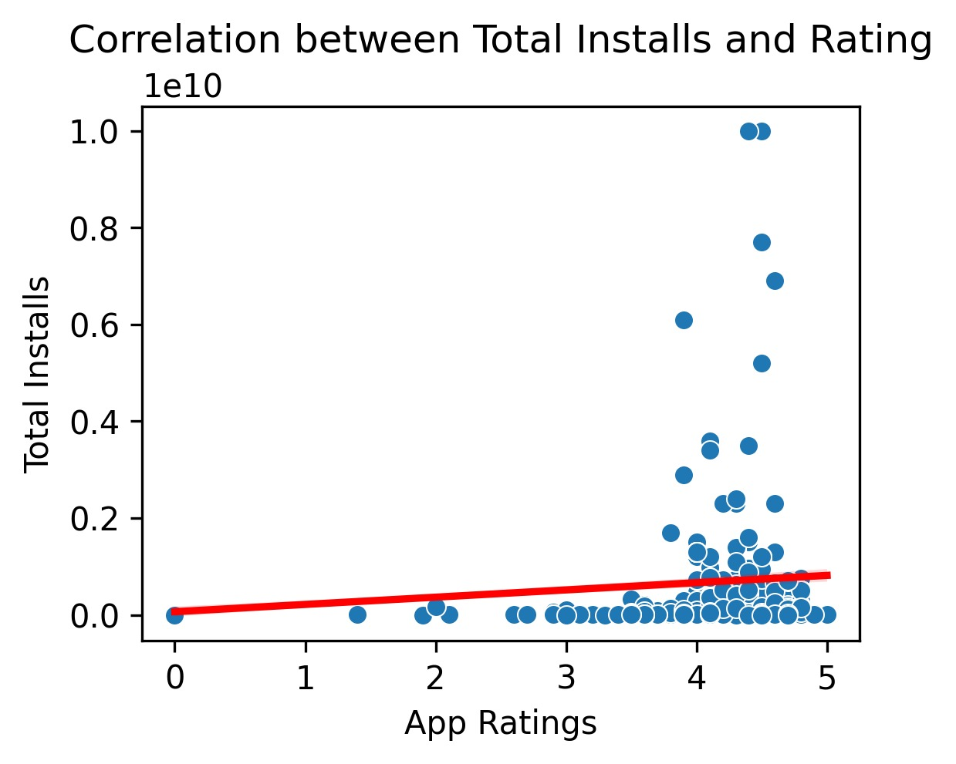
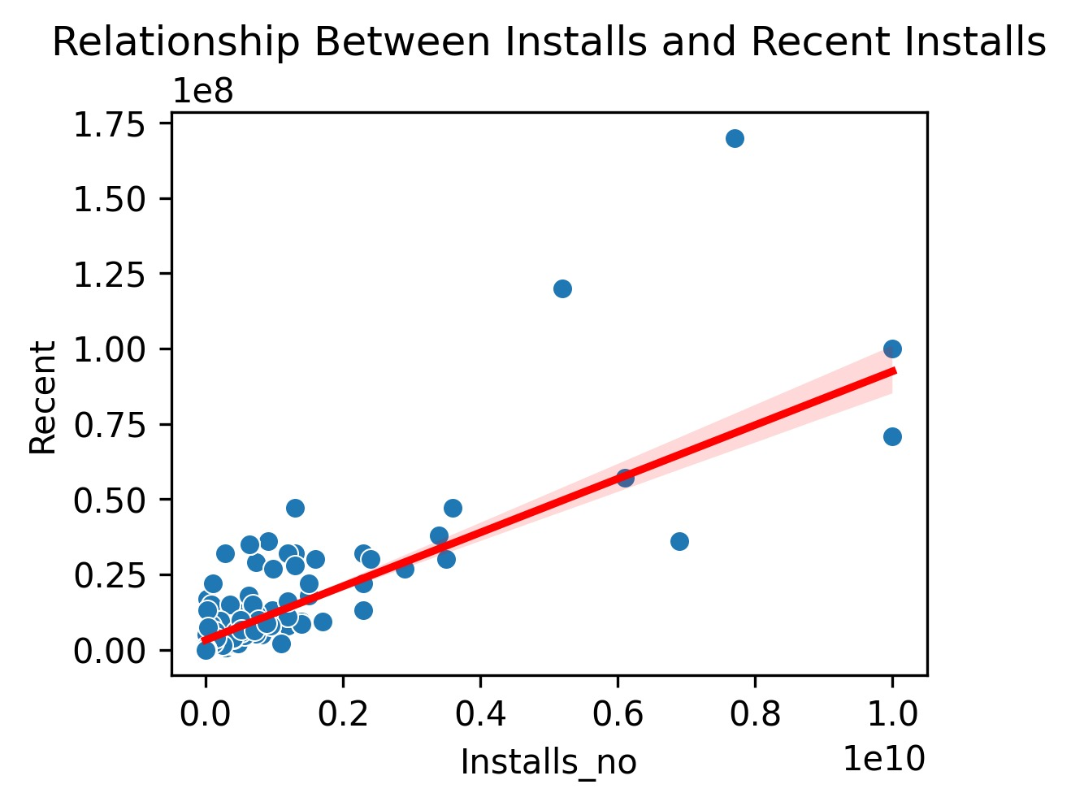
Bivariate Analysis – Num Vs Num
Highly rated apps tend to have more installs
Apps with higher total installs tend to have more recent installs.

Slide 12
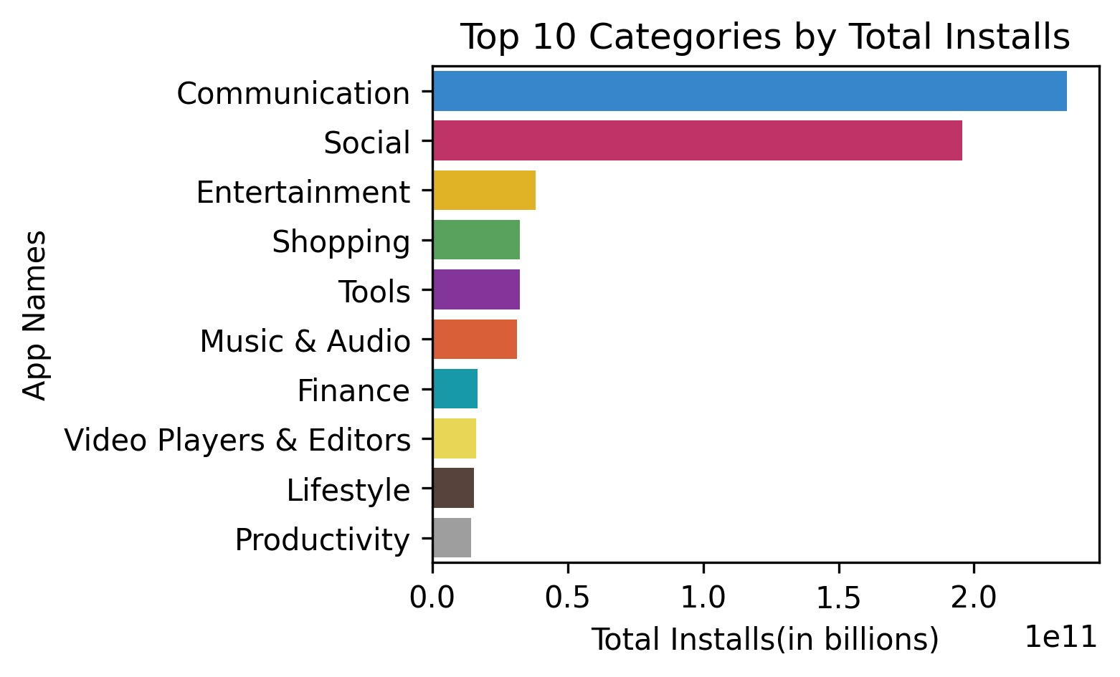
Bivariate Analysis – Num Vs Cat
The Communication category leads by a massive margin. This is expected due to the global popularity of apps like WhatsApp.
Social category also have significant user bases, each with several billion installs.
Categories like Shopping and Entertainment are also popular, indicating that e-commerce and media consumption apps have a large market share.
Tools and Finance categories, though not as massive, still maintain a strong presence

Slide 13
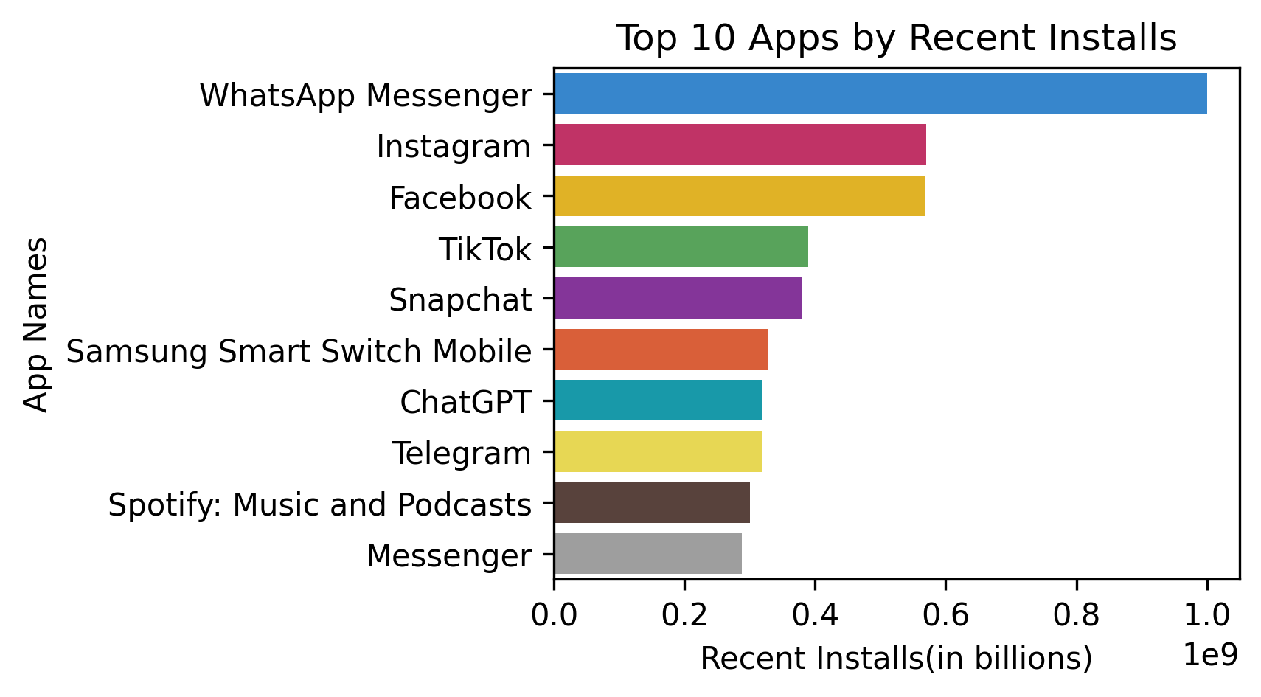
Bivariate Analysis – Num Vs Cat
WhatsApp Messenger leads the chart with the highest number of recent installs (100M+), indicating its ongoing massive popularity and frequent adoption.
Instagram and Facebook also have large userbases ,suggesting their market momentum.
ChatGPT* shows significant recent installs, highlighting the rising popularity of AI-based apps.

Slide 14
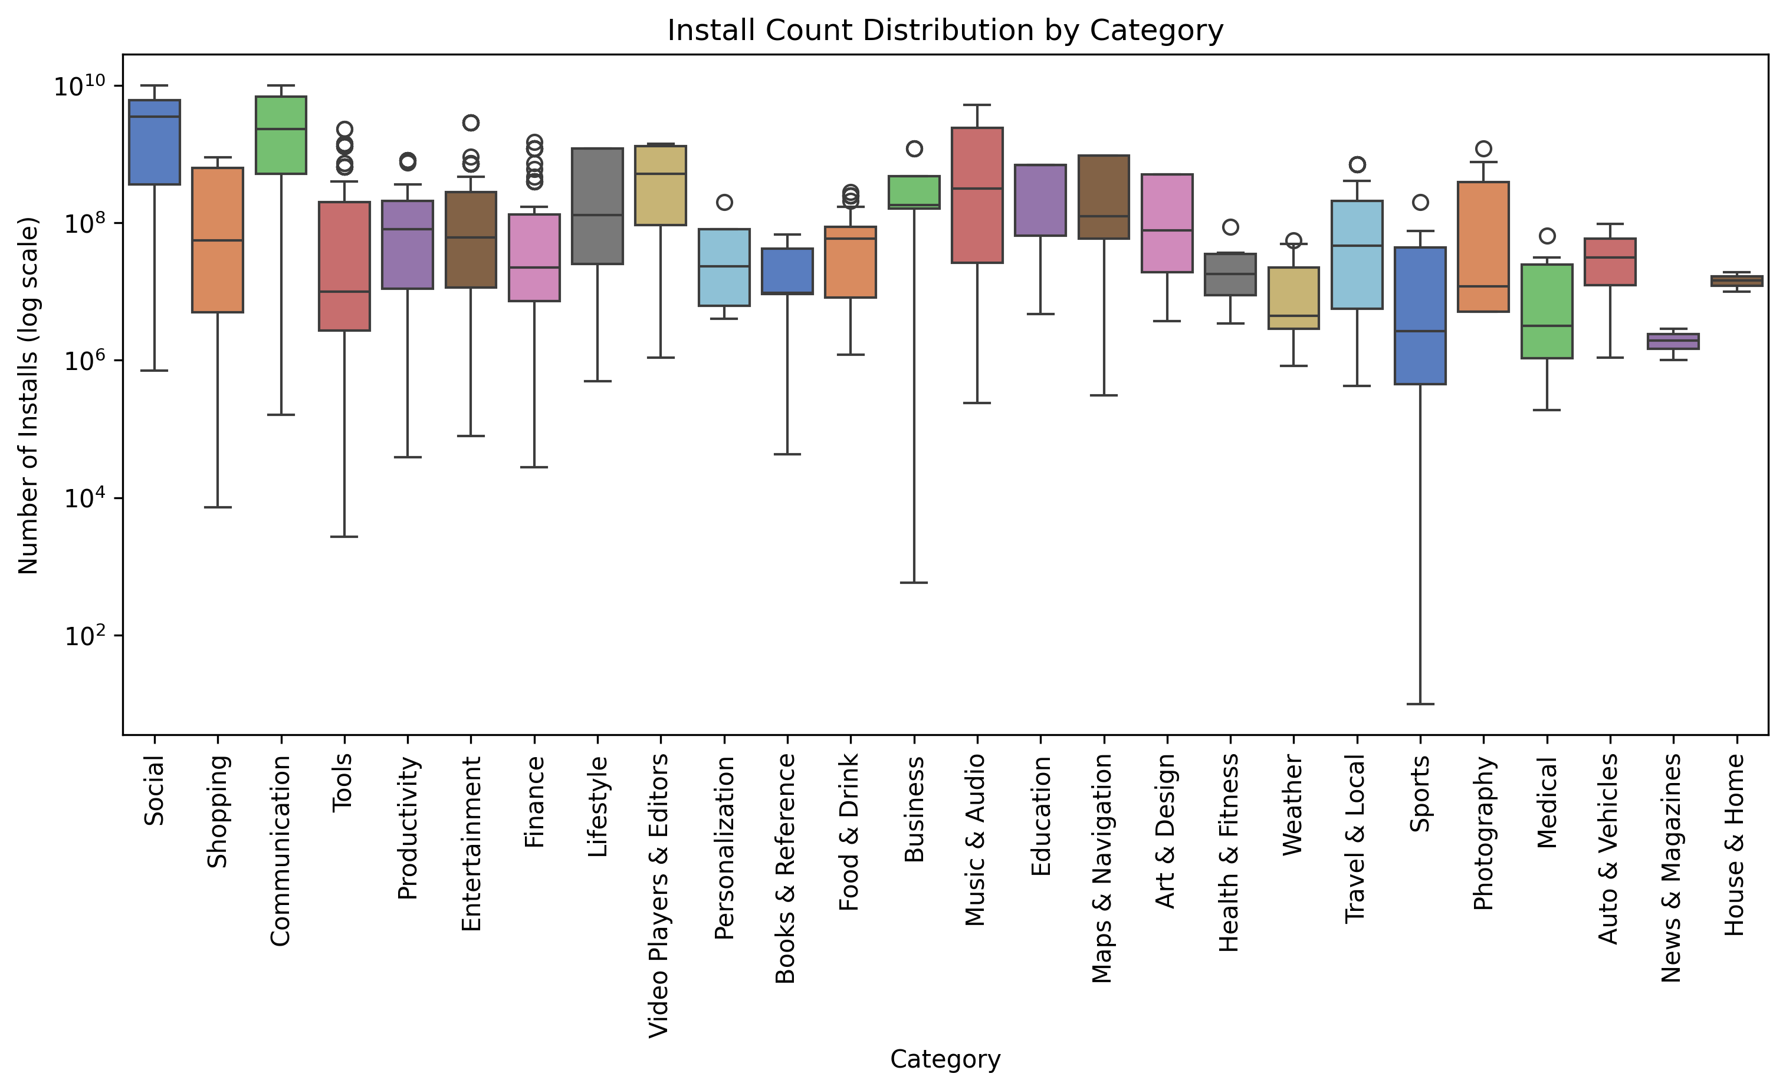
Bivariate Analysis – Num Vs Cat
Notes:
This will show how installs vary within each category, highlighting which categories have higher median installs and more variability.

Slide 15
Social and Communication apps dominate in terms of installs, with many reaching billions of downloads.
Categories like Weather, Medical tend to have lower install counts, possibly indicating more specialized or niche markets.
The blockbuster apps with billions of installs act as outliers, making the entire category seem more successful in terms of downloads. However, the reality is that the majority of apps have much lower install counts. This demonstrates how outliers can distort the overall interpretation of a category's performance.
The wide range of installs in categories like Tools and Productivity suggests a mix of widely-used and niche apps

Slide 16
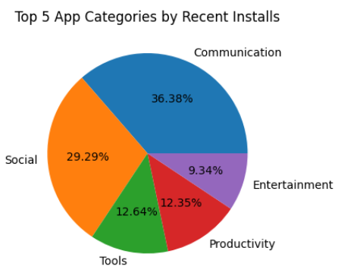
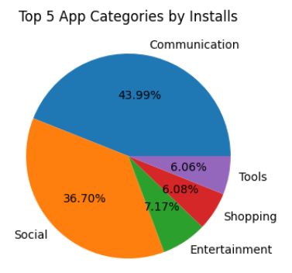
Bivariate Analysis – Num Vs Cat
Identifying the fastest-growing app categories, highlighting trending types that offer promising investment opportunities

Slide 17
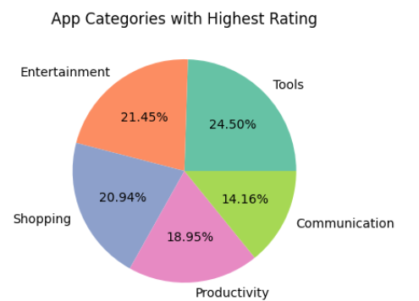
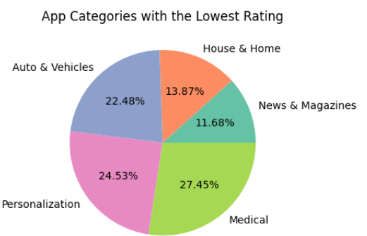
Bivariate Analysis – Num Vs Cat
Highlights categories with the most and least satisfied users, helping developers or businesses identify areas of strength and pinpoint opportunities for improvement.

Slide 18
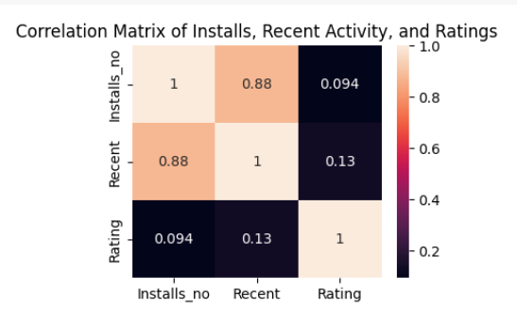
Multivariate Analysis
Sustained User Interest: The strong correlation between installs and recent activity suggests that popular apps continue to gain new users, indicating strong market presence.
Popularity ≠ Quality: The weak correlation between installs and ratings indicates that highly downloaded apps are not always highly rated.
No Strong Link to Ratings: Both installs and recent activity have minimal impact on the app ratings, highlighting that user satisfaction depends on factors beyond just popularity

Slide 19
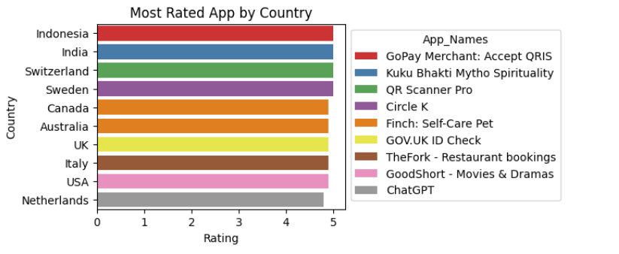
Multivariate Analysis
identifying region-specific app preferences and showcasing the leading apps with high user satisfaction in different countries.

Slide 20
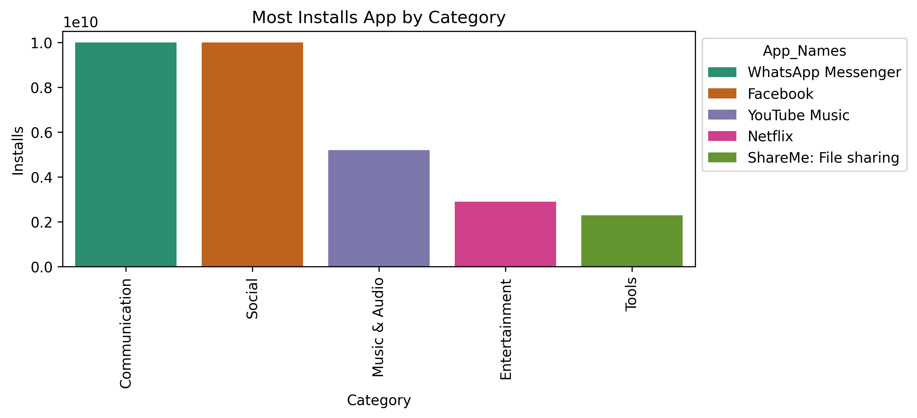
Multivariate Analysis
Communication and Social apps, led by WhatsApp Messenger and Facebook, dominate in terms of installs, highlighting their massive global reach and user base

Slide 21
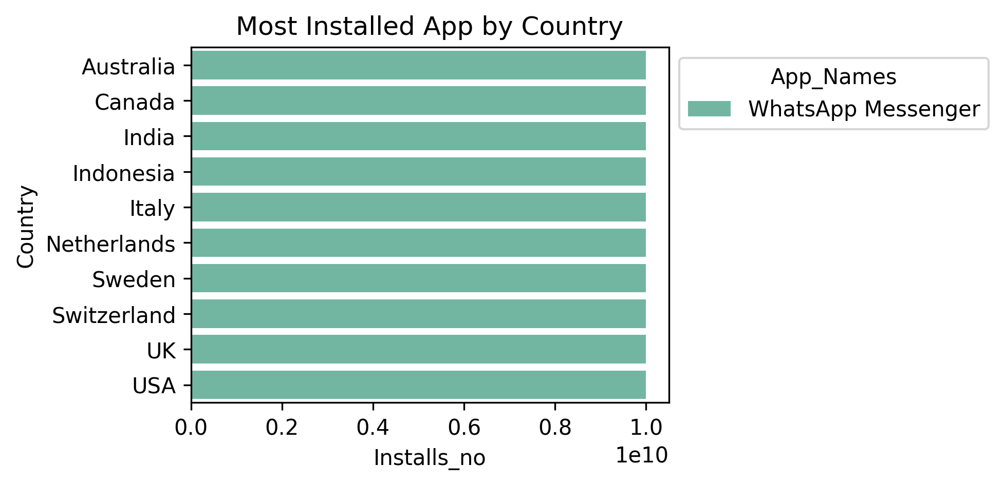
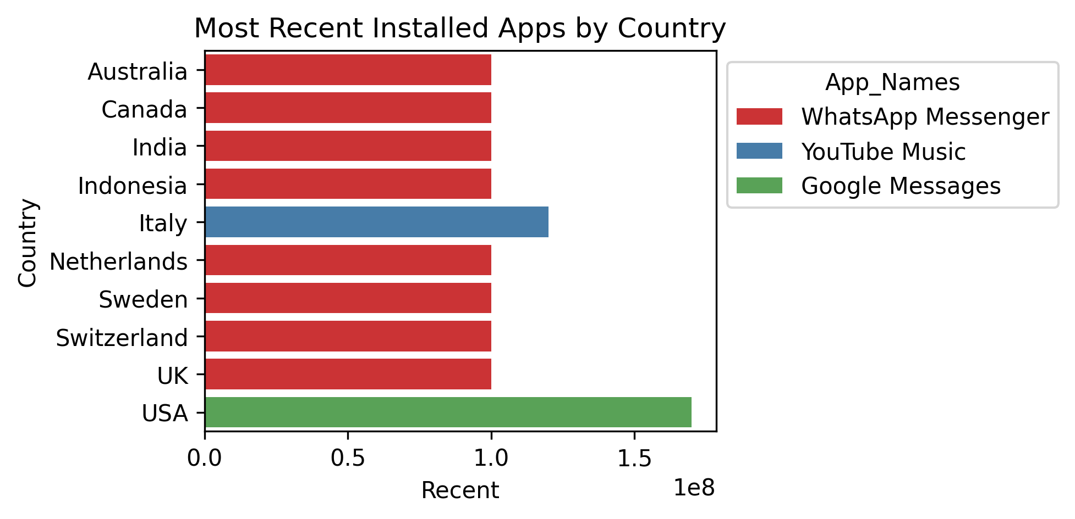
Multivariate Analysis

Slide 22
Conclusion
Data Insights & Market Trends :
Top Categories : Communication and Social apps lead the market, with apps like WhatsApp, Instagram, and Facebook dominating in terms of installs.
Growing Trends : AI-based apps (e.g., ChatGPT) are showing significant recent install growth.
Emerging Opportunities : Shopping and Entertainment apps also hold strong market positions.
Niche Markets : Categories like Weather, Medical, and Auto & Vehicles have lower installs, indicating specialized markets with less competition.

Slide 23
Data Analysis & Key Takeaways :
Apps with higher ratings generally have more installs.
Total installs correlate with recent installs, meaning apps that are historically popular tend to maintain their dominance.
Outliers (billion-install apps) distort the category’s overall success perception, meaning most apps have significantly lower installs than the leading apps.
Tools and Productivity apps show a mix of widely-used and niche applications, making them an interesting segment for potential investment.
Final Conclusion:
The app market is highly competitive, with a few dominant categories (Communication, Social, Shopping, and Entertainment) capturing most installs. AI-based apps are gaining traction, suggesting an emerging trend. Niche categories with lower installs, such as Medical and Auto & Vehicles, may provide growth opportunities with less competition. Understanding market trends and category performance is essential for strategic app development and investment decisions.

Slide 24

THANK YOU

